Slide 1
FEATURE ENGINEERING
BY:
ANJALI KADRE

Slide 2
FEATURE ENGINEERING
all machine learning algorithms use some input data to create outputs. This input data comprise features, which are usually in the form of structured columns. Algorithms require features with some specific characteristic to work properly. Here, the need for feature engineering arises. I think feature engineering efforts mainly have two goals:
Preparing the proper input dataset, compatible with the machine learning algorithm requirements.
Improving the performance of machine learning models.

Slide 3
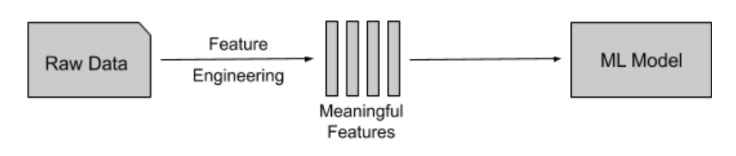
Feature Engineering is a basic term used to cover many operations that are performed on the variables(features)to fit them into the algorithm.
It helps in increasing the accuracy of the model thereby enhances the results of the predictions.
Feature Engineered machine learning models perform better on data than basic machine learning models.

Slide 4
List of Techniques of Feature engineering :
1.Imputation
2. Encoding

Slide 5
What is imputation technique ?
Imputation is the technique in ML that is used to handle missing values in our dataset.
Missing values are one of the most common problems you can encounter when you try to prepare your data for machine learning.
The statistical approach of handling missing values uses the mean, median, or mode imputations.

Slide 6
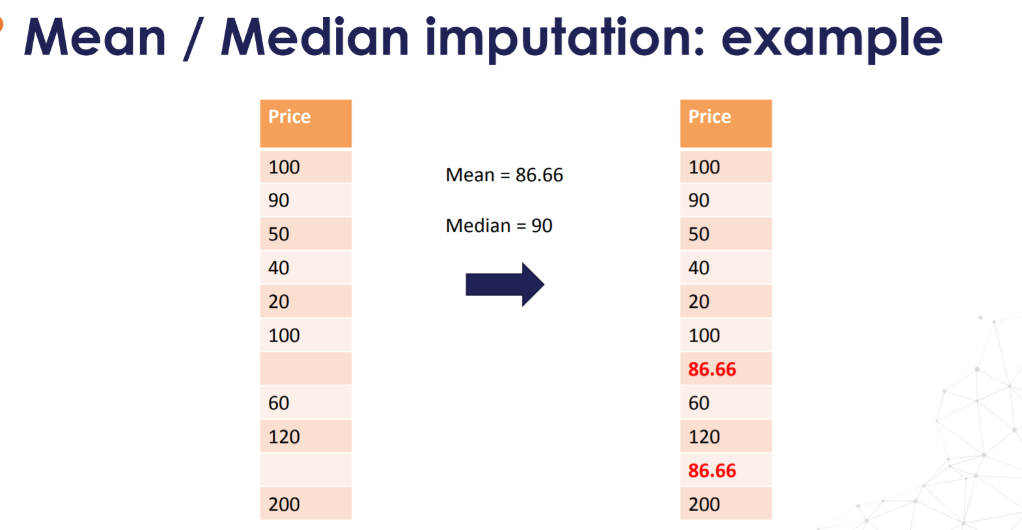

Slide 7
What is feature encoding ?
Feature Encoding is used for the transformation of a categorical feature into a numerical variable. Most of the ML algorithms cannot handle categorical variables and hence it is important to do feature encoding.

Slide 8
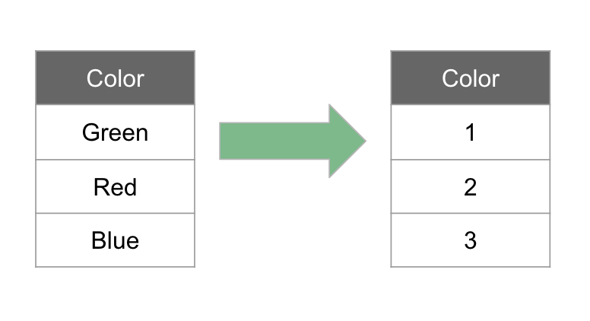

Slide 9
Types of feature encoding
1. Label Encoding
2. One Hot Encoding

Slide 10
Label encoding
Label Encoding refers to converting the labels into numeric form so as to convert it into the machine-readable form.
Machine learning algorithms can then decide in a better way on how those labels must be operated.
It is an important pre-processing step for the structured dataset in supervised learning.

Slide 11
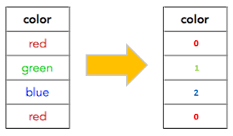
Example of label encoding

Slide 12
One Hot Encoding
One-Hot Encoding: To overcome the Disadvantage of Label Encoding, we can use One-Hot Encoding strategy.
A one hot encoding allows the representation of categorical data to be more expressive.
One-hot encoding is processed in 2 steps:
Splitting of categories to different columns.
Put ‘0 for others and ‘1’ as an indicator for the appropriate column.

Slide 13

Example of one hot encoding

Slide 14
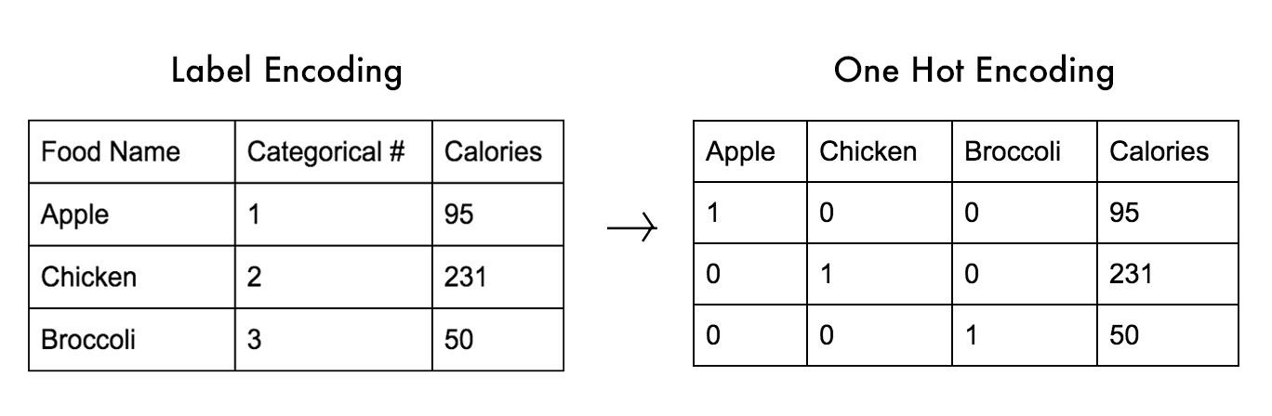

Slide 15
THANK YOU

